Slide 1
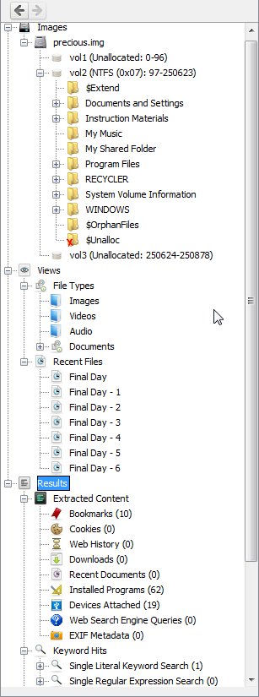
Image Data
Views
Results
Keyword Hits

Slide 2
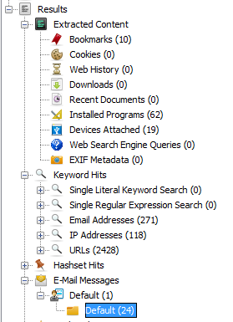

Slide 3
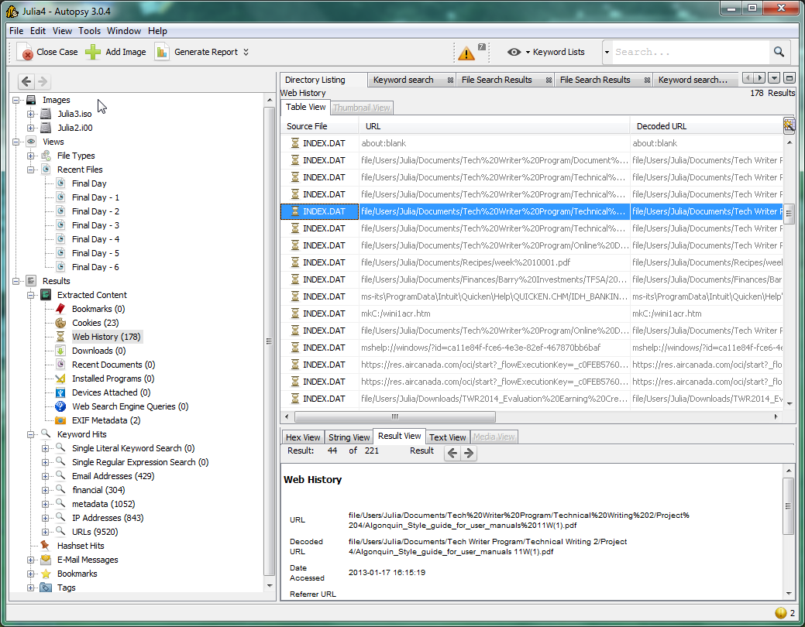
Result Viewer
Content Viewer
Data Explorer

Slide 4
Internet data extracted by Recent Activity ingest module
Results from keyword search for Internet information.
Extracted by the Thunderbird Parser ingest module.

Slide 5
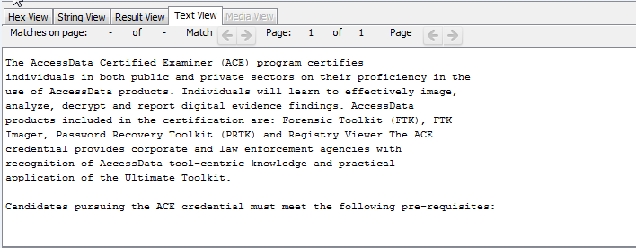

Slide 6
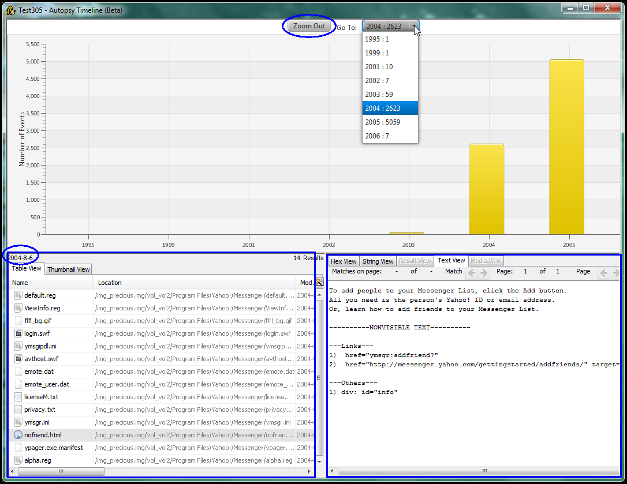
Date of file activity
Result Viewer
Content Viewer

Slide 7
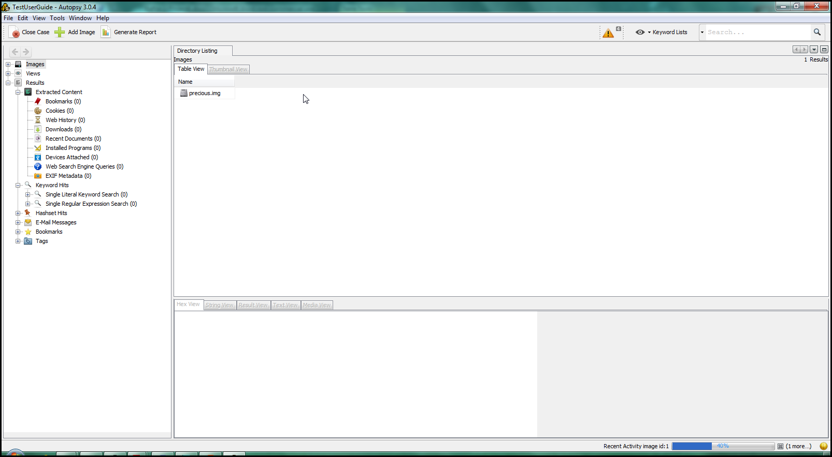

Slide 8
Internet data extracted by Recent Activity ingest module
Extracted by the Thunderbird Parser ingest module.

Slide 9
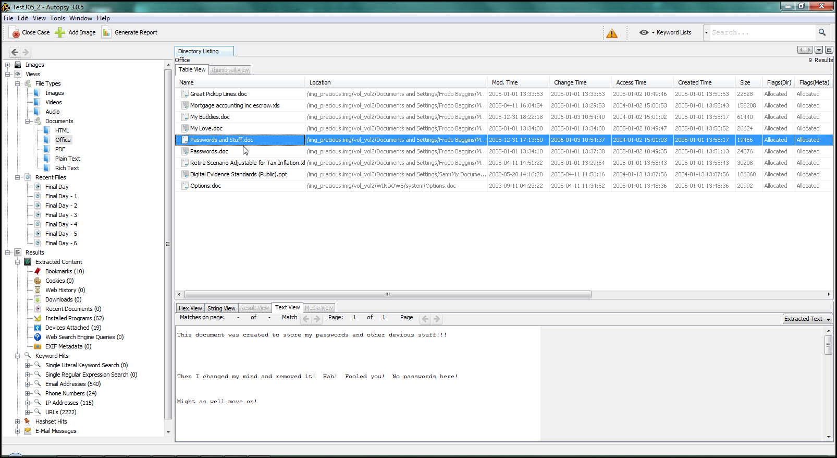
0
Data Explorer
Result Viewer
Content Viewer

